Slide 1
Housing Prices in California
Alisha Kartik, Ibrahim Khalid, Rahul Majmudar Group 7
DATA 230
Dr. Guannan Liu
Final Project Presentation
Notes:
Rahul

Slide 2
Introduction

Slide 3
Research Problem
Housing in California is facing a major crisis as the gap between house prices and wages increases
We are looking to explore the factors playing into this crisis
Our key research questions are as follows
What relation is there, if any, between demographics and affordability over time?
How does the market affect certain demographics ability to buy a house?
How does the market relate to the home prices and what does this say about the relation between buyers and sellers?
How does the general home price relate to income needed to buy a home over time?

Slide 4
Datasets
California Census Data
This dataset contains a demographic breakdown by education, gender, age, race, and income (2008-2024) showing number of persons per group combination
Zillow Research Data
ZHVI (Zillow Home Value Index): Time series data of typical home values (1996-2025)
Zillow Market Heat Index Dataset: Measure of a seller’s advantage in housing markets (2018-2025)
Zillow Affordability Dataset: Annual household income required to afford a typical home while spending less than 30% of income on housing (2012-2025)
Data Integration Approach:
Zillow will be combined amongst itself while we will perform parallel analysis between zillow data and demographic data

Slide 5
Exploratory Data Analysis

Slide 6
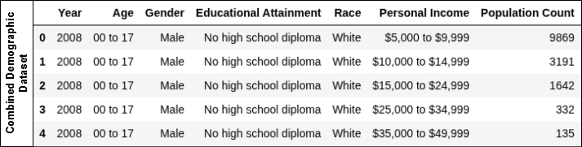
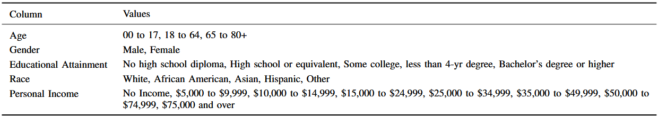
Data Exploration
The Census dataset consists of the number of persons based on their specific demographics
The dataset is from 2008 to 2024 except the year 2020
Age ranges are <18, 18-64, and 64+
Only include Male and Female genders
Educational attainment and personal income shown
The values for 2020 were interpolated using corresponding values of 2019 and 2021

Slide 7
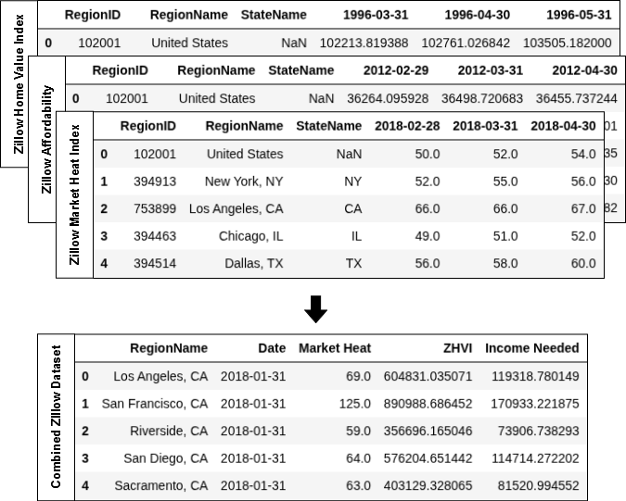
Data Exploration (Cont.)
The zillow datasets follow a time series format where each column is a certain point in time
Each dataset is contains one specific value type
ZHVI - Zillow Home Value Index
Market Heat
Income Needed
We combined the various zillow datasets into a more manageable format

Slide 8
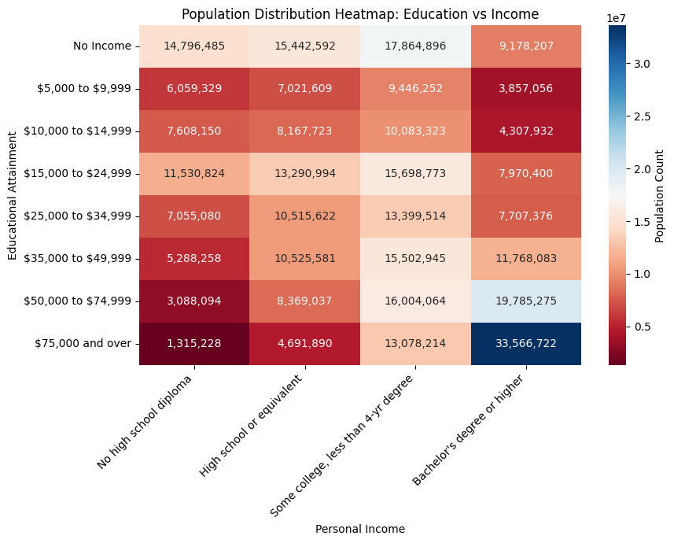

Slide 9
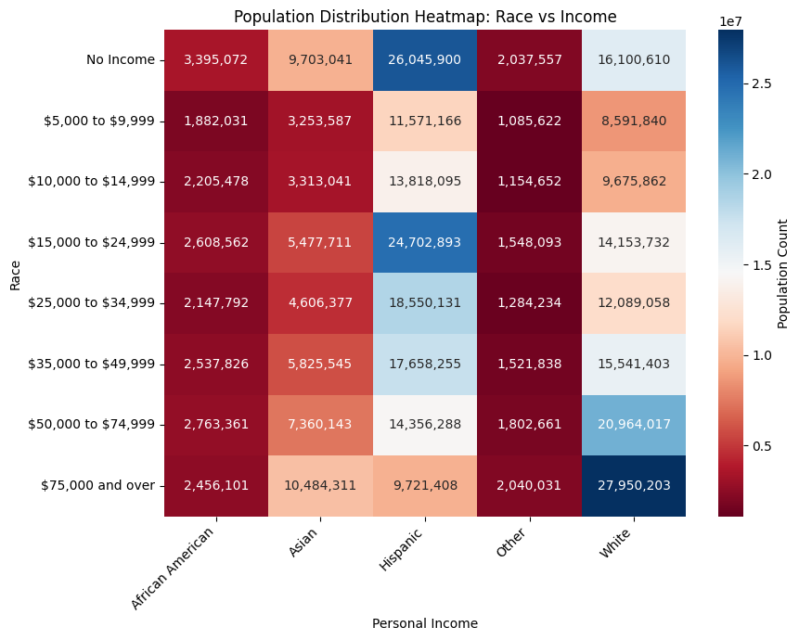

Slide 10
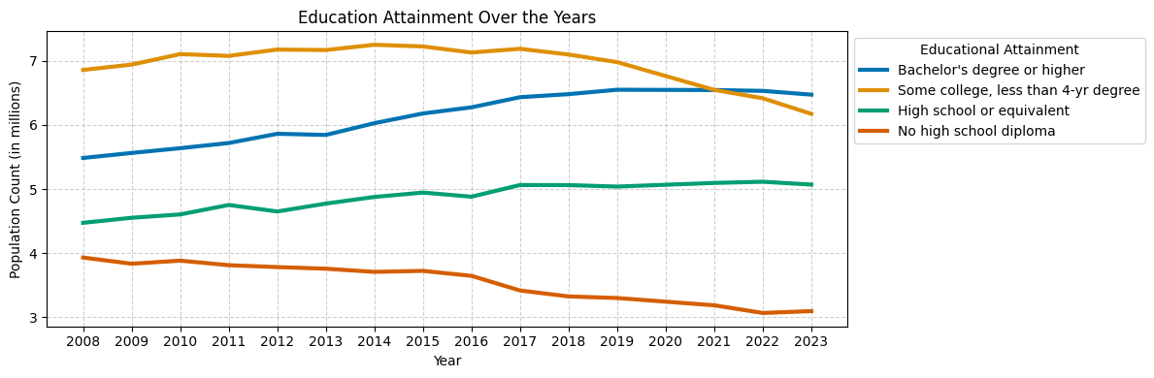

Slide 11
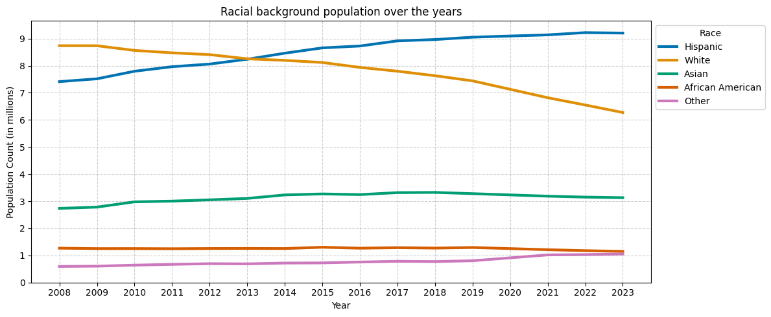

Slide 12
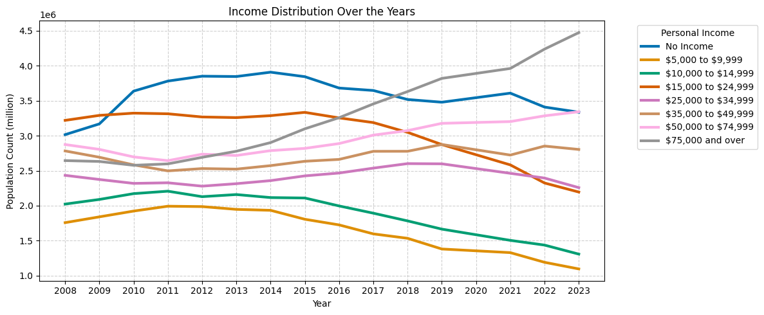

Slide 13
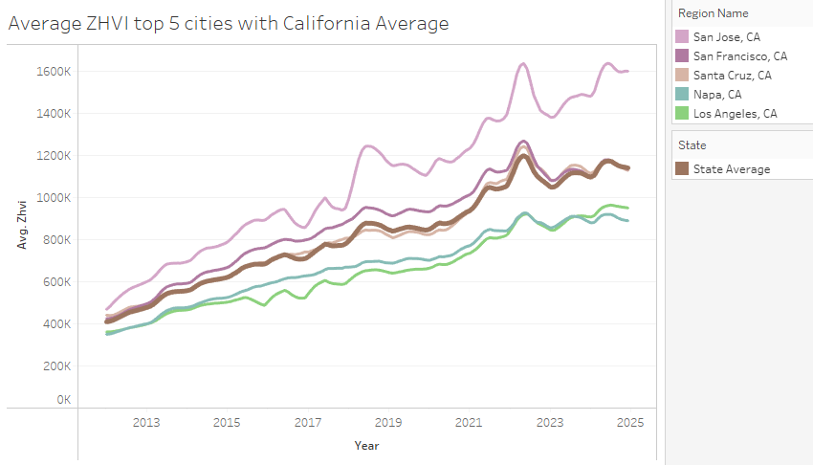

Slide 14
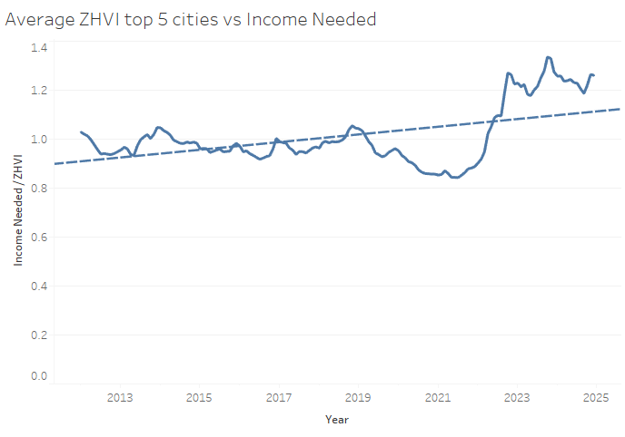

Slide 15
Interactive dashboards
Notes:
Alt tab here to show the actual dashboards in action

Slide 16
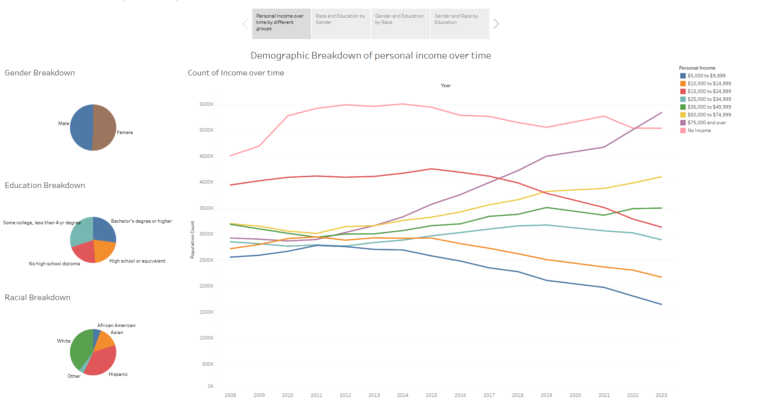

Slide 17
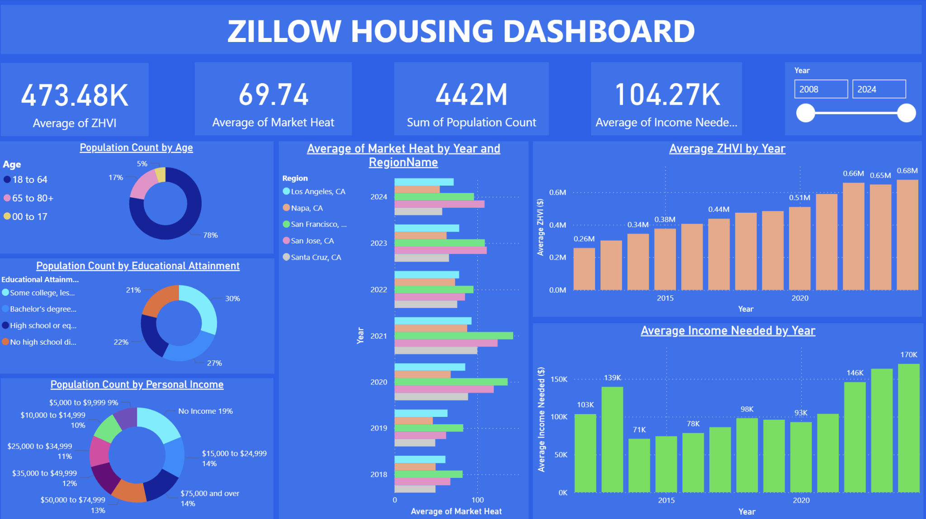

Slide 18
ML Analysis - ARIMA Models for Demographics and Housing
Notes:
Rahul - from here until end of presentation

Slide 19
What is ARIMA and why use it?
ARIMA = AutoRegressive (AR) + Integrated (I) + Moving Average (MA)
Think of it as a statistical "crystal ball" specifically designed for time-based data
Perfect for demographics and housing because it can:
Identify underlying patterns in both population demographic and housing price changes
It accounts for both long-term trends and short-term fluctuations
It shows the uncertainty in its future projections

Slide 20
How We Found the Right Model
Testing Strategy:
Essentially tested ARIMA models from (0,0,0) → (2,2,2) for each demographic group and housing region to see the best fit with the least error (will explain the numbers next slide)
Finding the Best Fitting Model:
Some models were too simple (missed important patterns)
Some were too complex (over-analyzed random fluctuations)
We used AIC (Akaike Information Criterion) for each parameter set to see which fit best and come up with the optimal parameters for each demographic group and housing region
Notes:
AIC tells you how well the parameters fit the model. The lower the AIC, the better the fit

Slide 21
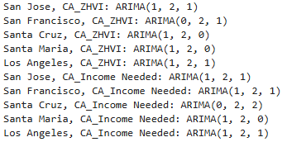
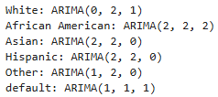
What the Numbers Mean: ARIMA(p,d,q)
p: How many past years influence the current year
d: How many times we need to calculate year-over-year differences
q: How many past prediction errors influence the current prediction
Housing: Demographics:
Income Distribution, Age, and total population were found to work well with the default ARIMA(1,1,1) based on AIC analysis

Slide 22
Key Technical Insights
Insights:
All Groups Need d=2: Suggests acceleration (not just growth) in population and housing changes
Different AR Patterns (p values): Groups vary in how past values predict future ones
Validation Precision: Regardless, the models predict with 95.4-99.7% R-squared accuracy across all demographic groups and housing region predictions
Notes:
R-squared accuracy measures the proportion of variance explained by the model. Our R² of 0.954-0.997 indicates that 95.4-99.7% of the variance in the data is explained by our ARIMA model.
so to summarize the accuracy and validation: What was done is using the AIC value to find the best fitting model, and then validating this model fit using R-squared accuracy metric. The final accuracy for all of the models ranged from 95.4%-99.7% which validates the ARIMA predictions.

Slide 23
Insights

Slide 24
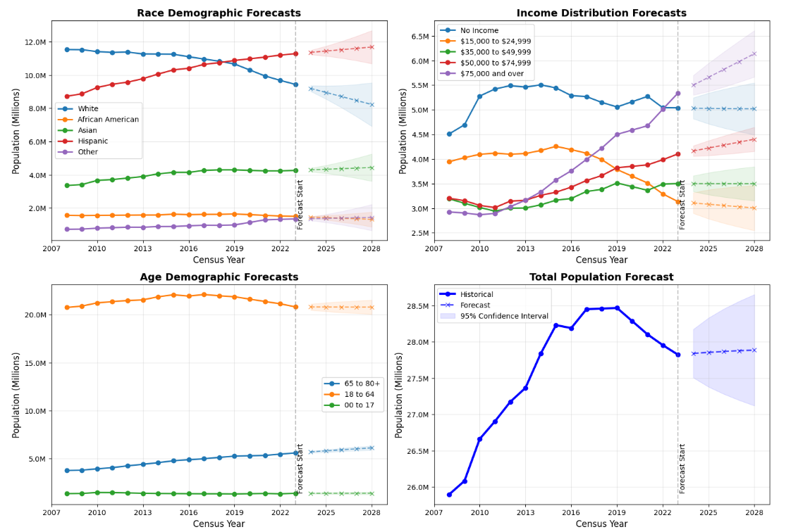
Notes:
Race Demographics - Hispanic population overtaking White population by 2028. Why: Changing migration patterns and higher birth rates in Hispanic communities reshaping housing needs toward multi-generational homes and culturally diverse communities.
Income Polarization - High-income and low-income groups expanding while middle-income shrinks. Why: Economic restructuring and technology sector growth creating a bifurcated housing market with luxury and subsidized housing demand outpacing middle-market options.
Aging Population - Seniors (65+) showing consistent growth while youth population remains flat. Why: Baby boomer aging and longer lifespans driving increased demand for accessible, single-level homes and senior-oriented communities.
Population Stabilization - After recent decline, modest growth resuming post-2025. Why: High housing costs drove outmigration, but California's economic opportunities still attract newcomers, creating a more balanced population outlook that may help housing markets normalize.

Slide 25
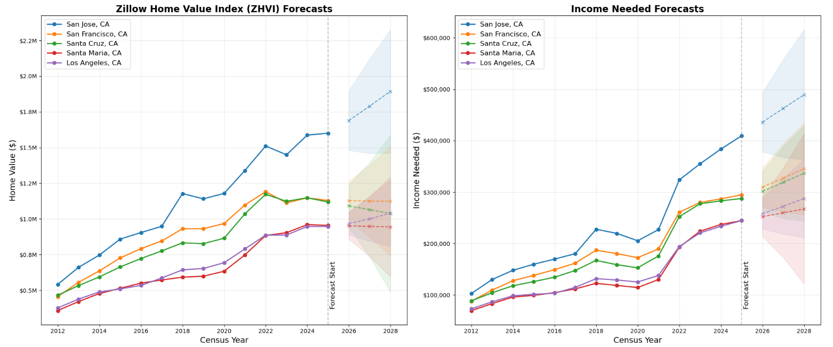
Notes:
ZHVI Regional Divergence - San Jose projected to reach $1.9M by 2028, nearly double Los Angeles values at $1M. Why: Persistent tech sector dominance and severe supply constraints in Silicon Valley create extreme price premiums, while secondary markets face more modest growth due to lower employment density and greater housing availability.
Income Affordability Crisis - Required income in San Jose forecasted to exceed $500K by 2028, with even mid-tier markets requiring $300K+. Why: Rising interest rates combined with continued price appreciation push homeownership increasingly out of reach for middle-income Californians, transforming coastal cities into enclaves for high-income households and generational wealth. (TLDR u and ur partner potentially need to be making 250k a piece to comfortably afford a house in sj within the next few years)
Optimal ARIMA Model Parameters:
San Jose, CA_ZHVI: ARIMA(1, 2, 1)
San Francisco, CA_ZHVI: ARIMA(0, 2, 1)
Santa Cruz, CA_ZHVI: ARIMA(1, 2, 0)
Santa Maria, CA_ZHVI: ARIMA(1, 2, 0)
Los Angeles, CA_ZHVI: ARIMA(1, 2, 1)
San Jose, CA_Income Needed: ARIMA(1, 2, 1)
San Francisco, CA_Income Needed: ARIMA(1, 2, 1)
Santa Cruz, CA_Income Needed: ARIMA(0, 2, 2)
Santa Maria, CA_Income Needed: ARIMA(1, 2, 0)
Los Angeles, CA_Income Needed: ARIMA(1, 2, 1)

Slide 26
California Housing Affordability Outlook (2025-2028)
Persistent market growth:
Housing values across all major California regions are projected to rise through 2028, with San Jose approaching $2M and requiring $500K+ income.
Affordability crisis worsening:
Income requirements consistently outpacing likely wage growth, further challenging middle-income households.
Stabilizing secondary markets:
Areas like Santa Cruz and Santa Maria show more moderate growth projections, potentially offering relatively better affordability options.

Slide 27
Conclusions and Future Work
Conclusion:
ARIMA models successfully captured the diverse patterns across demographic groups and housing markets
Housing affordability in California is worsening as time progresses
Future Work:
Test alternative time series approaches (SARIMA, Prophet, LSTM neural networks) for comparison
Expand regional analysis to include markets beyond just California (Finding more comprehensive datasets)

Slide 28
Links
Datasets
California Census dataset
https://data.census.gov/app/mdat/ACSPUMS1Y2008
https://data.census.gov/app/mdat/ACSPUMS1Y2009
…
https://data.census.gov/app/mdat/ACSPUMS1Y2023
Zillow Research Datasets
https://www.zillow.com/research/data/
Home Values
Market Heat Index
Affordability (New Homeowner Income Needed)
Dashboard
Tableau demographic dashboard

Slide 29
Thank You

